Slide 1

Chapter 1: Intro to Network Security Management
Gonzalo De La Torre Parra, Ph.D.
Fall 2021

Slide 2
Overview
Security management is one of the most overlooked domains, yet almost nothing we do in the other domains means anything without it. Security management is made up of several tasks:
Risk assessments, which is the process we use to identify risks to the organization and systemically identify methods to combat those risks, usually relying on input from experts in the below domains
Overseeing the processes for other security functions to ensure those align with business/operations processes
Change management processes and procedures in place
User security awareness training

Slide 3
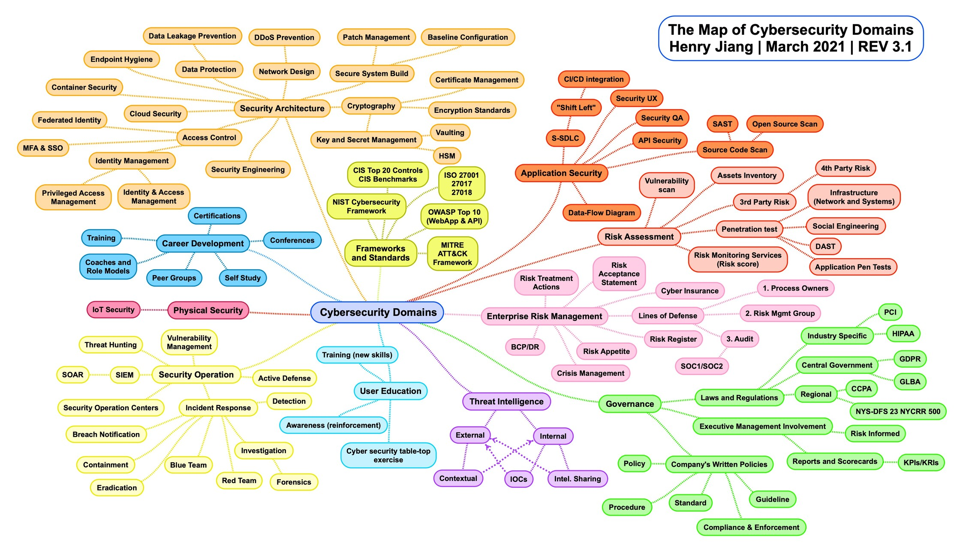

Slide 5
Motivation – Network Security Management
Digitalization of resources
Decentralization of information processing (Federated, Decentralized)
Global business environment (More users, networks, protocols, and technologies)
Dynamic business place
Work while traveling
Work from home
Novel technologies with weak computational resources and security systems (E.g. IoT)

Slide 6
Acknowledging the problem
Information security is recognized as an imperative vehicle by which the organization’s information assets are secured.
Security is not only responsibility of a dedicated group. All employees are responsible.
New units and positions are created to focus on this task (E.g. Information Security Managers and Teams)

Slide 7
Key terms: Speaking the same language
Asset: An organizational resource that is being protected. E.g., Web site, software information, data, a person, computer system, hardware, etc. Assets, particularly information assets, are the focus of what security efforts are attempting to protect.
Information asset: The focus of information security; information that has value to the organization, and the systems that store, process, and transmit the information.
Information security (InfoSec): Protection of the confidentiality, integrity, and availability of information assets, whether in storage, processing, or transmission, via the application of policy, education, training and awareness, and technology.
Security: A state of being secure and free from danger

Slide 8
Specialized Security Areas
Physical Security
Operation Security
Communications Security
Cyber Security: The protection of computerized information processing systems and the data they contain and process.
Network Security: A subset of communications security and cybersecurity; the protection of voice and data networking components, connections, and content.

Slide 9
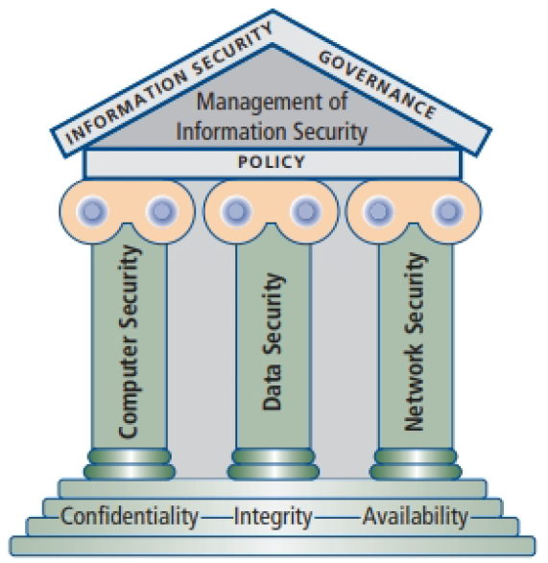
Information Security as defined by the Committee on National Security Systems {CNSS)
Information security (lnfoSec) focuses on the protection of information and the characteristics that give it value, such as confidentiality, integrity, and availability, and includes the technology that houses and transfers that information through a variety of protection mechanisms such as policy, training and awareness programs, and technology.

Slide 10
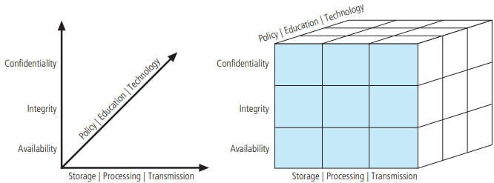
CNSS Security Model - McCumber Cube
Comprehensive Model of InfoSec that serves as the standard for understanding many aspects of InfoSec, and shows the three dimensions that are central to the discussion of InfoSec: information characteristics, information location, and security control categories.
You must make sure that each of the 27 cells is properly addressed by each of the three communities of interest.
E.g. Technology, integrity, and storage
Controls to protect information such as host intrusion detection and prevention systems.

Slide 11
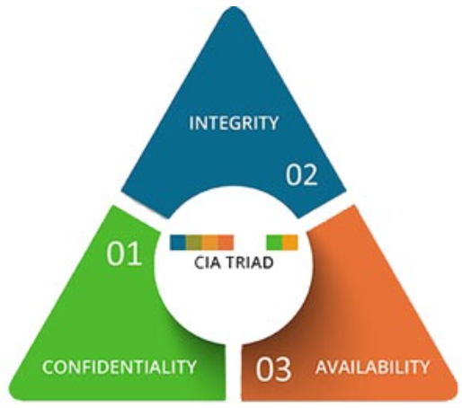
CIA Triad
Information security revolves around the three key principles: confidentiality, integrity and availability (CIA).
Key characteristics of information that make it valuable to an organization

Slide 12
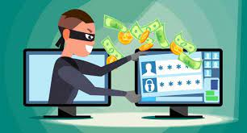
What is Confidentiality?
Confidentiality measures are designed to protect against unauthorized disclosure of information. The objective of the confidentiality principle is to ensure that private information remains private and that it can only be viewed or accessed by individuals who need that information in order to complete their job duties.

Slide 13
What is Confidentiality?
While U.S. federal agencies have had lapses that resulted in unwanted data disclosures, an event in July 2015 eclipsed all previous similar lapses.
The loss of 21.5 million federal background-check files rocked the Office of Personnel Management (OPM)
Revealing names, addresses, financial records, health data, and other sensitive private information
Chinese hackers (Believed to be responsible)

Slide 14
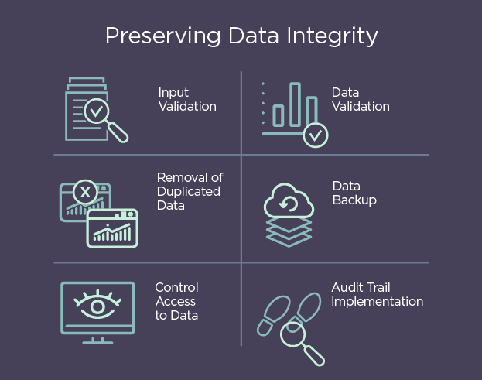
What is Integrity?
Integrity involves protection from unauthorized modifications (e.g., add, delete, or change) of data. The principle of integrity is designed to ensure that data can be trusted to be accurate and that it has not been inappropriately modified.

Slide 15
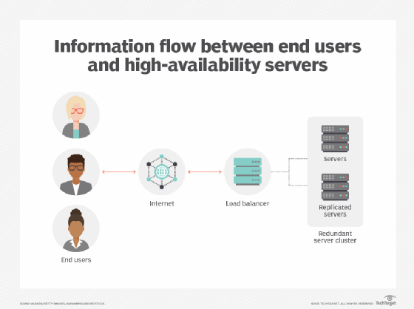
What is availability?
Availability is protecting the functionality of support systems and ensuring data is fully available at the point in time (or period requirements) when it is needed by its users. The objective of availability is to ensure that data is available to be used when it is needed to make decisions.

Slide 16
Additional Characteristics
Privacy: Information that is collected, used, and stored by an organization should be used only for the purposes stated by the data owner at the time it was collected.
Identification: An information system possesses the characteristic of identification when it is able to recognize individual users.
Authentication: Authentication is the process by which a control establishes whether a user (or system) is the entity it claims to be.
Authorization: After the identity of a user is authenticated, a process called authorization defines what the user (whether a person or a computer) has been specifically and explicitly authorized by the proper authority to do, such as access, modify, or delete the contents of an information asset.
Accountability of information: occurs when a control provides assurance that every activity undertaken can be attributed to a named person or automated process.

Slide 17
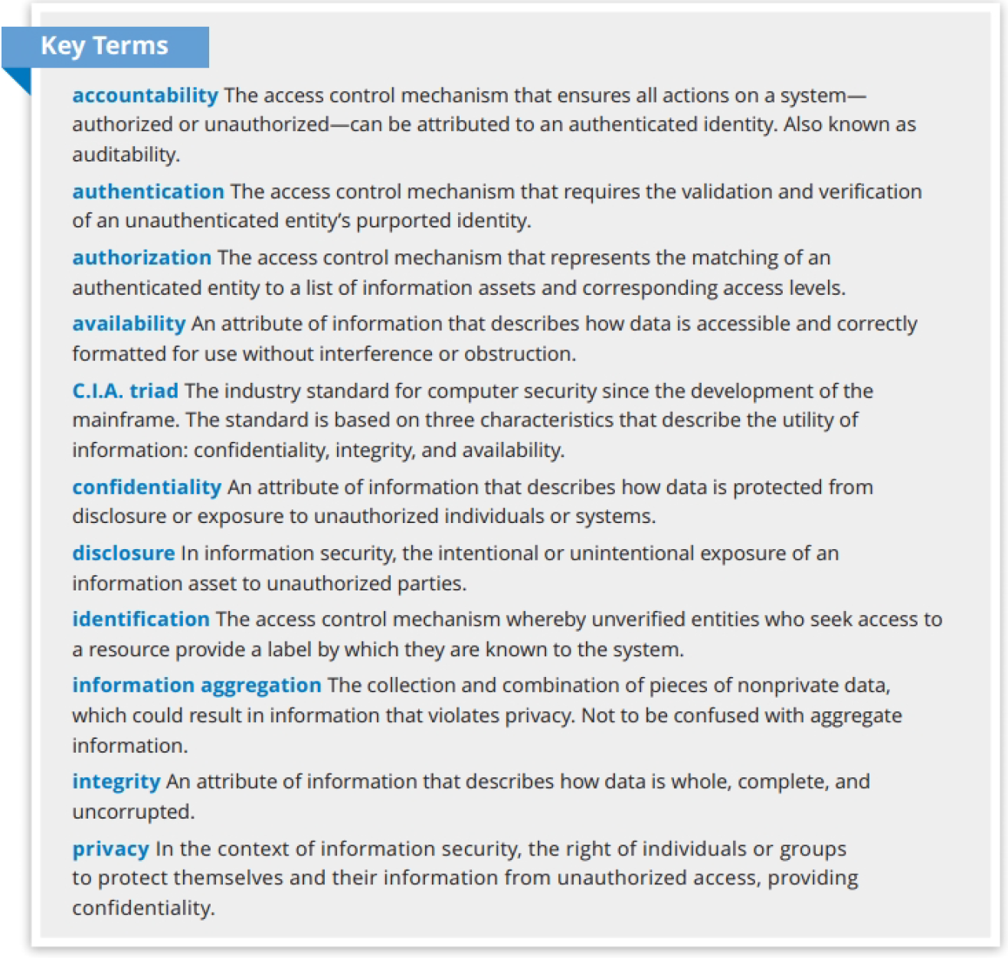

Slide 18
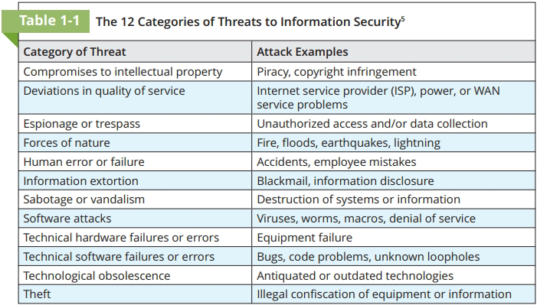
The 12 Categories of Threats

Slide 19
Threats and Attacks

Slide 20
Compromises to Intellectual Property
Software piracy
Copyright protection and user registration

Slide 21
Deviations in Quality of Service
Internet service issues
Communications and other service provider issues
Power irregularities

Slide 22
Espionage or Trespass
Novice Hackers: have little or no real expertise of their own, but rely upon the expertise of expert hackers, who often become dissatisfied with attacking systems directly and turn their attention to writing software. These programs are automated exploits that allow novice hackers to act as script kiddies or packet monkeys.
Professional Hackers: usually a master of several programming languages, networking protocols, and operating systems, and exhibits a mastery of the technical environment of the chosen targeted system. Once an expert hacker chooses a target system, the likelihood is high that he or she will successfully enter the system.
Password Attacks
Brute Force
Dictionary Attacks
Social Engineering

Slide 23
Forces of Nature
Forces of nature, sometimes called acts of God, can present some of the most dangerous threats because they usually occur with little warning and are beyond the control of people.
These threats, which include events such as fires, floods, earthquakes, and lightning as well as volcanic eruptions and insect infestations, can disrupt not only people's lives but also the storage, transmission, and use of information.

Slide 24
Software Attacks
Malware – Referred to as malicious code or malicious software. Malicious code attacks include the execution of viruses, worms, Trojan horses, and active Web scripts with the intent to destroy or steal information.
Polymorphic Malware - A polymorphic threat that evolves, changing its size and other external file characteristics to elude detection by antivirus software programs.

Slide 25
Software Attacks
Back doors - A malware payload that provides access to a system by bypassing normal access controls.
Bot - Automated software program that executes certain commands when it receives a specific input.
DoS - An attack that attempts to overwhelm a computer ta rget's ability to handle incoming communications, prohibiting legitimate users from accessing those systems.
Man-in-the-Middle - Group of attacks whereby a person intercepts a communications stream and inserts himself in the conversation to convince each of the legitimate parties that the attacker is the other communications partner

Slide 26
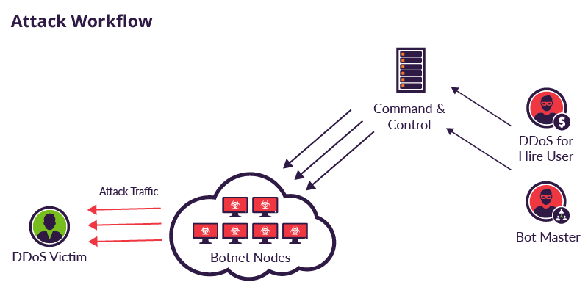
E.g. Botnet
https://github.com/epsylon/ufonet
https://github.com/malwaredllc/byob

Slide 27
Human Error or Failure
Advance-fee fraud (AFF) – the recipient is due an exorbitant amount of money and needs only a small advance fee or personal banking information to facilitate the transfer
Phishing - Contains hidden or embedded code that redirects the reply to a third-party site to extract personal or confidential information
Social Engineering: Convince people to reveal credentials
Spear phishing: Targeted phishing attacks

Slide 28
Information Extortion and Ransomware
Information extortion – Threat to reveal stolen information
Ransomware – Software that encrypts valuable information. This approach is used to extort a victim and ask for a payment in exchange of the decryption key.
Colonial pipeline: 4.4 Billion
CWT: 4.5 million

Slide 29
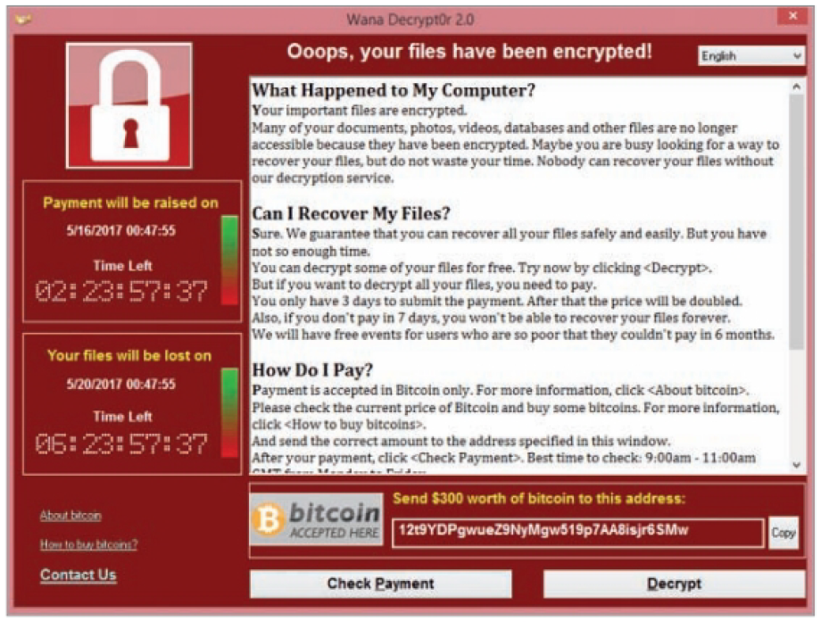
Ransomware Example

Slide 30
Sabotage and Vandalism
Cyber activist and hacktivist - A hacker who seeks to interfere with or disrupt systems to protest the operations, policies, or actions of an organization or government agency.
Cyber terrorism - The conduct of terrorist activities by online attackers.
Cyber warfare - Formally sanctioned offensive operations conducted by a government or state against information or systems of another government or state. Sometimes called information warfare.

Slide 31
Technological Obsolescence
Windows 7
Windows Vista
Windows XP
Signature-based Intrusion Detection Systems (Stand Alone)

Slide 32
Management and Leadership

Slide 33
Management Definition
Management - The art of using the resources to get the job done
Manager - A member of the organization assigned to marshal and administer resources, coordinate the completion of tasks, and handle the many roles necessary to complete the desired objectives.

